Slide 1
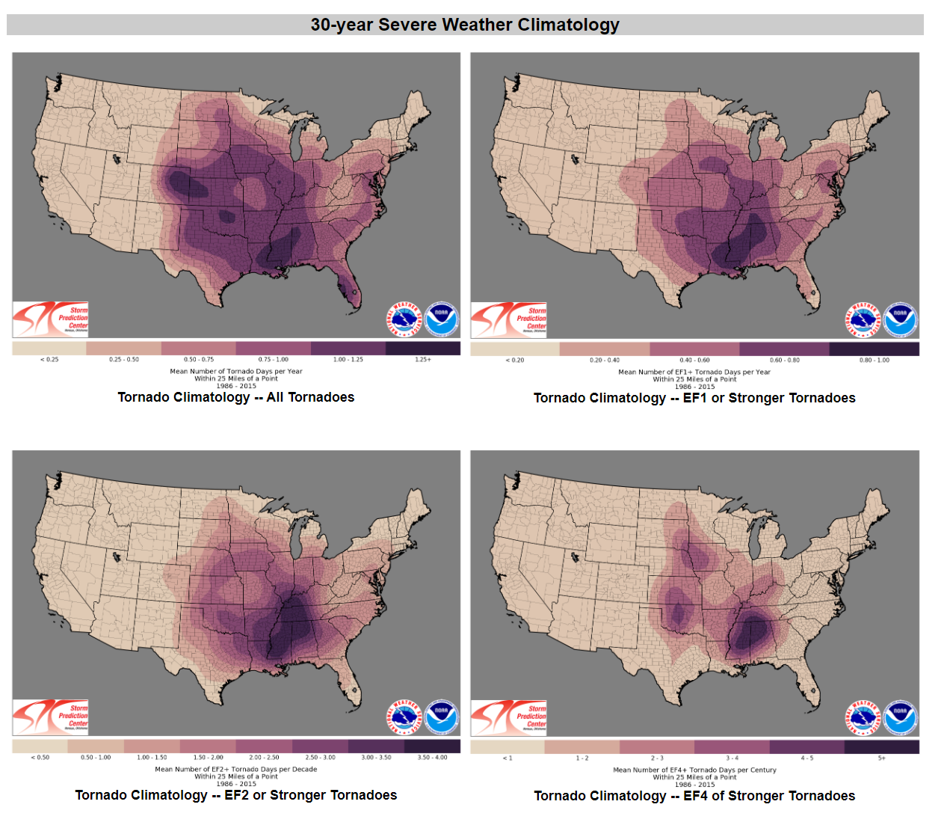
NOAA
Tornado
Data
Analysis
Laura Zhang

Slide 2
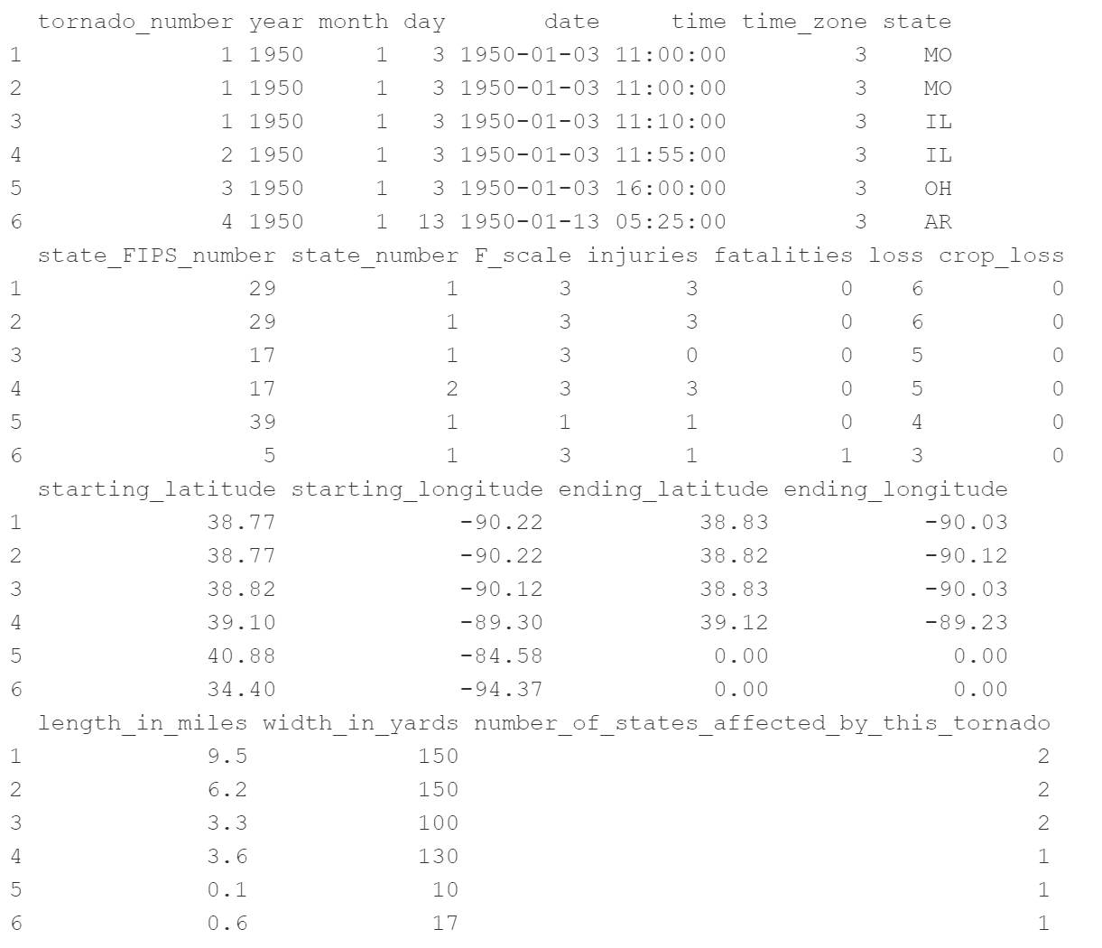
Scale for rating tornado intensity:
F-scale
(Fujita scale)
Ranges from 0 to 5
Health and economic consequences:
Injuries
Fatalities
Loss
Property loss ($)

Slide 3
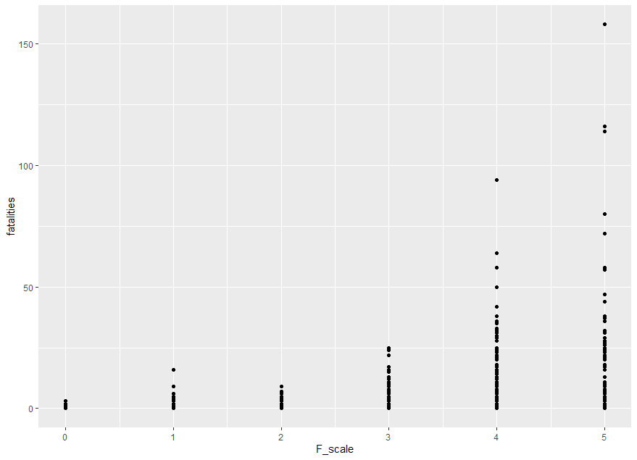
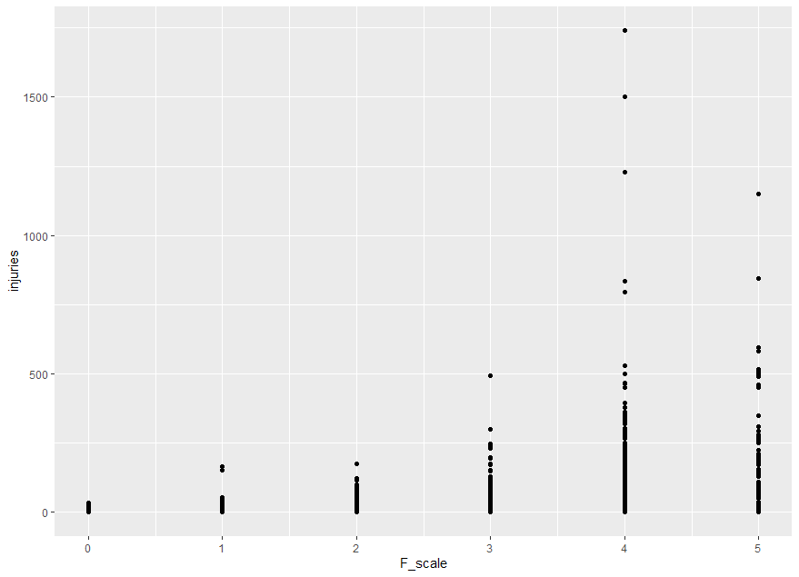
Positive correlation
between F-scale and fatalities
Roughly positive correlation
between F-scale and injuries

Slide 4
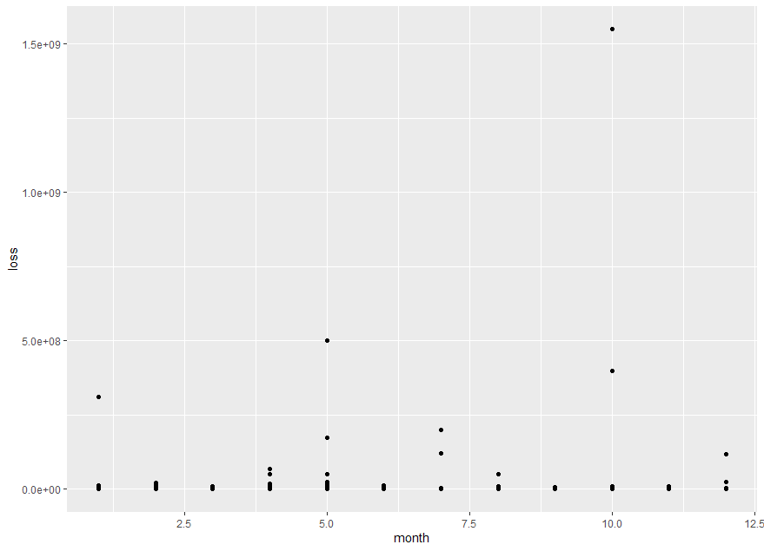
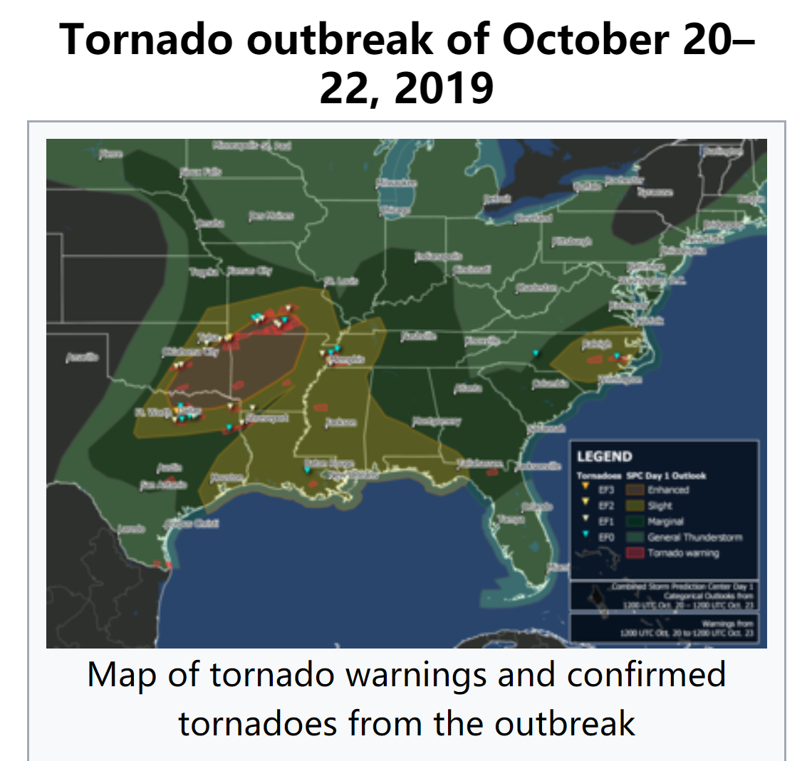
Outlier: significant property losses
2019-10-20 in Texas
the most property loss in the record ($1,550,000,000)
only caused 4 injuries and 0 fatality

Slide 5
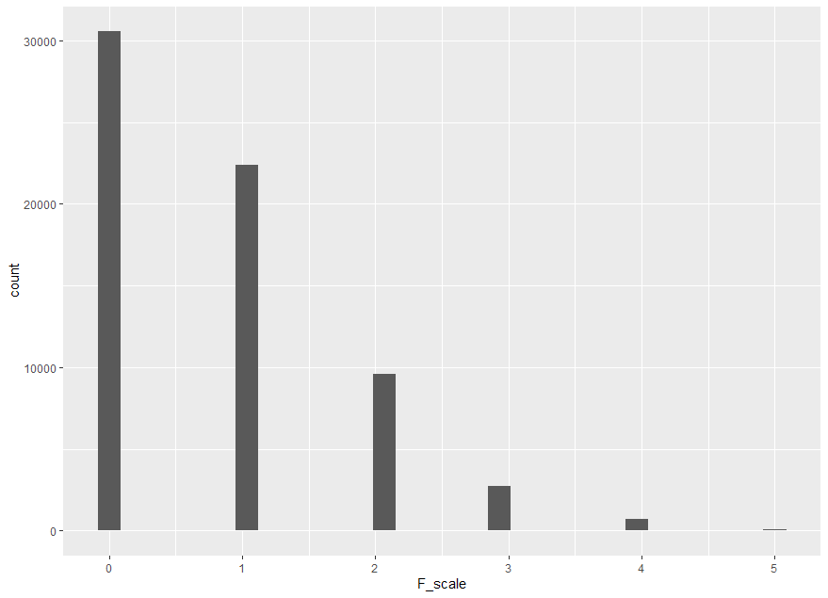
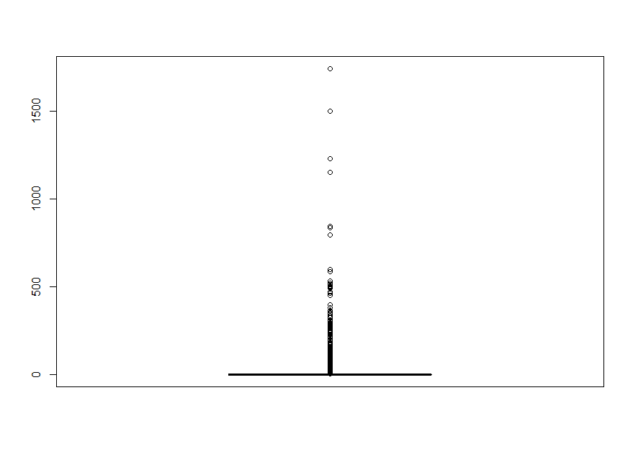
Histogram:
count of cases in different F-scales
Boxplot:
Recorded injuries per case

